Slide 1







Pembangunan System Web PHP & MYSQL (Tutorial Bahasa Melayu)
bit.ly/fstmtubephp

Slide 2

T00 PHP + LARAGON
w
bit.ly/fstmtube

Slide 3




3-tier
Tier3 : Database
Tier1 : Client/browser
Tier2 : Middleware (Webserver + PHP)

Slide 4


T1: CLIENT (BROWSER HTML)
The User-interface

Slide 5

T2: Web server + PHP interpreter
Hold logic/ business process
Server-side scripting
Dynamic web

Slide 6

T3: DATABASE
Place to hold database/records/data

Slide 7

LARAGON.ORG
Development stack
https://laragon.org/download.html
Apache/ Nginx / PHP/ MySQL / NodeJS / etc…

Slide 8
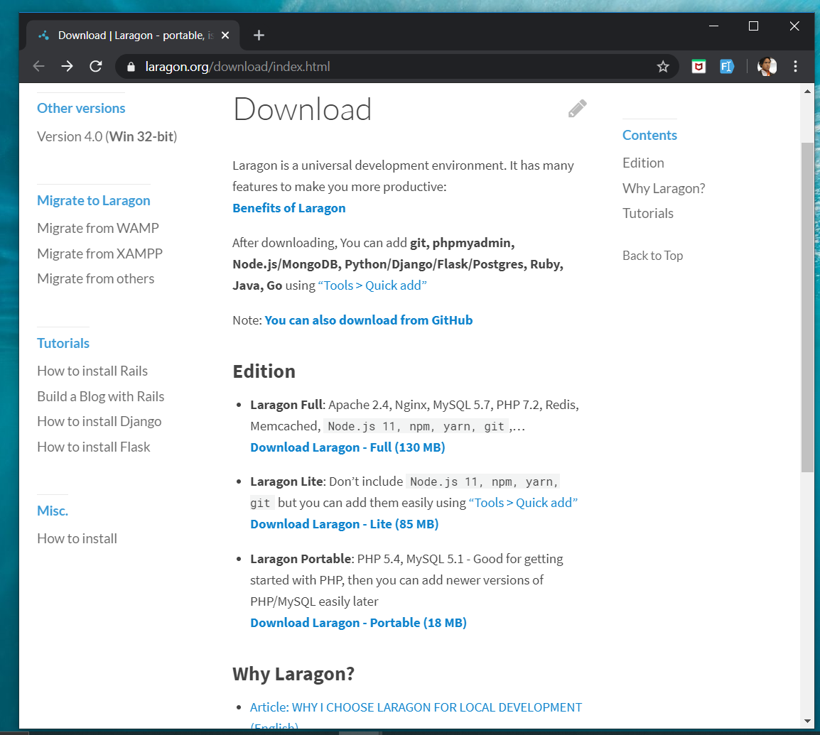
DOWNLOAD FROM LARAGON.org
Laragon.org

Slide 9
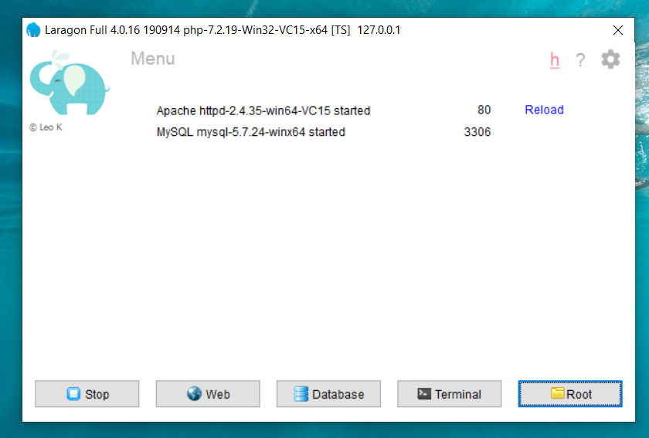
LARAGON INTERFACE
Start/stop servers
localhost
db client (HeidiSQL)
cli/npm/composer
go to webroot folder

Slide 10
T01 Antaramuka HTML5 Pembangunan System Web PHP & MYSQL
bit.ly/fstmtubephp

Slide 11
T01 HTML5
w
bit.ly/fstmtube

Slide 12
Training outline
HTML5 – refers to the modern day of HTML which promotes native handling of video & audio & animation without having to install additional plugins to browser.
Bootstrap – A HTML framework supports responsive web design to provide one time webpage development for smartphone, tablet and desktop.

Slide 13
HTML5
HTML5 – refers to the modern day of HTML which promotes native handling of video & audio & animation without having to install additional plugins to browser.
<!DOCTYPE html>
Try: https://www.w3schools.com/html/tryit.asp?filename=tryhtml_headings

Slide 14
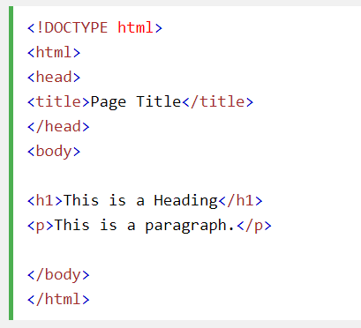
Typical HTML CODE

Slide 15
HTML5 image handling
<img src="pic_mountain.jpg" alt="Mountain View" style="width:304px;height:228px;">
Use width 100% to support responsive layout design.
Try: https://www.w3schools.com/html/tryit.asp?filename=tryhtml_images_trulli

Slide 16
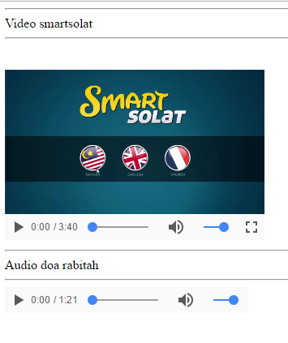
HTML5 Native video
<video width="320" height="240" controls> <source src="movie.mp4" type="video/mp4"> <source src="movie.ogg" type="video/ogg"> Your browser does not support the video tag. </video>
Try: https://www.w3schools.com/html/tryit.asp?filename=tryhtml5_video

Slide 17
HTML5 Native AUDIO
<audio controls> <source src="horse.ogg" type="audio/ogg"> <source src="horse.mp3" type="audio/mpeg"> Your browser does not support the audio element. </audio>

Slide 18
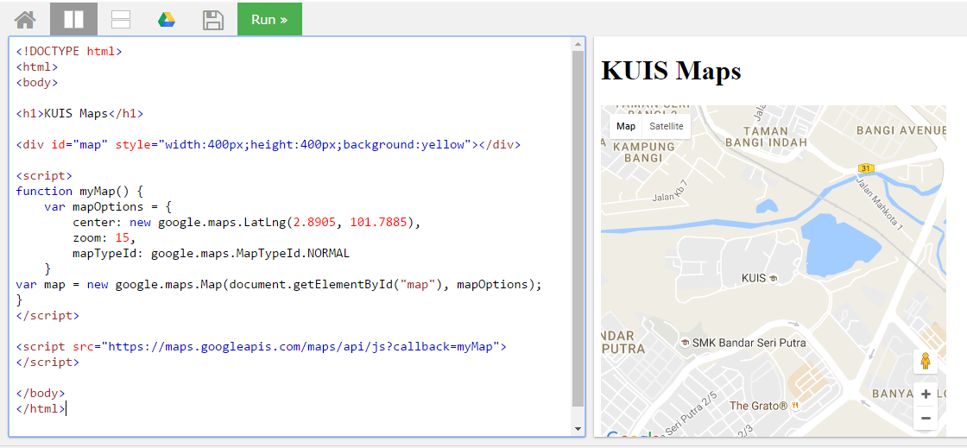
Location MAPS

Slide 19
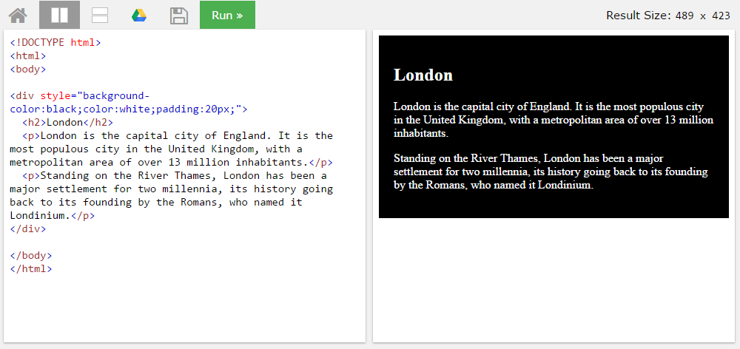
BLOCK <DIV>

Slide 20
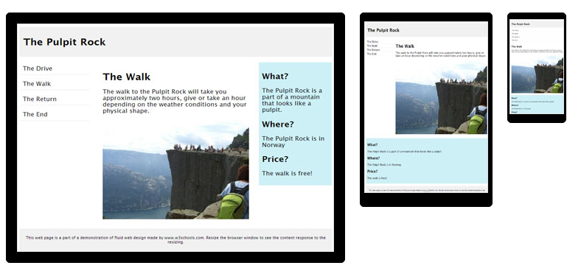
HTML Responsive layout

Slide 21
HTML Responsive layout
What is Responsive Web Design?
Responsive Web Design makes your web page look good on all devices (desktops, tablets, and phones).
Responsive Web Design is about using CSS and HTML to resize, hide, shrink, enlarge, or move the content to make it look good on any screen

Slide 22
VIEWPORT
<meta name="viewport" content="width=device-width, initial-scale=1">
The viewport varies with the device, and will be smaller on a mobile phone than on a computer screen.
The initial-scale=1.0 part sets the initial zoom level when the page is first loaded by the browser.

Slide 23
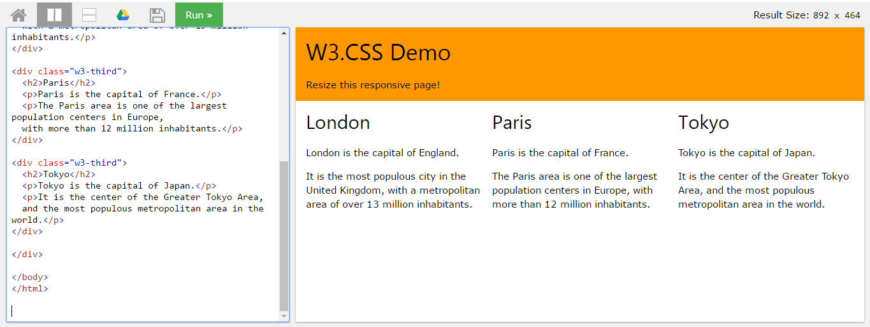
HTML Responsive layout

Slide 24
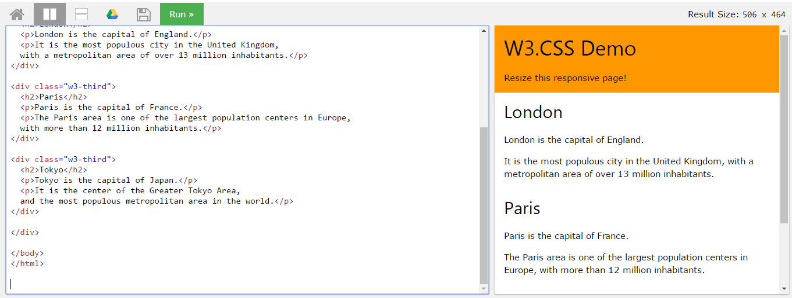
HTML Responsive layout

Slide 25
T02 Bootstrap + PHP Include Pembangunan System Web PHP & MYSQL
bit.ly/fstmtubephp

Slide 26
T02 BOOTSTRAP + PHP include
w
bit.ly/fstmtube

Slide 27

Bootstrap
A HTML framework supports responsive web design to provide one time webpage development for smartphone, tablet and desktop.

Slide 28
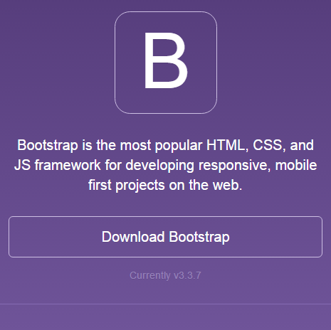
Bootstrap
Download framework from getbootstrap.com
OR use the CDN

Slide 29
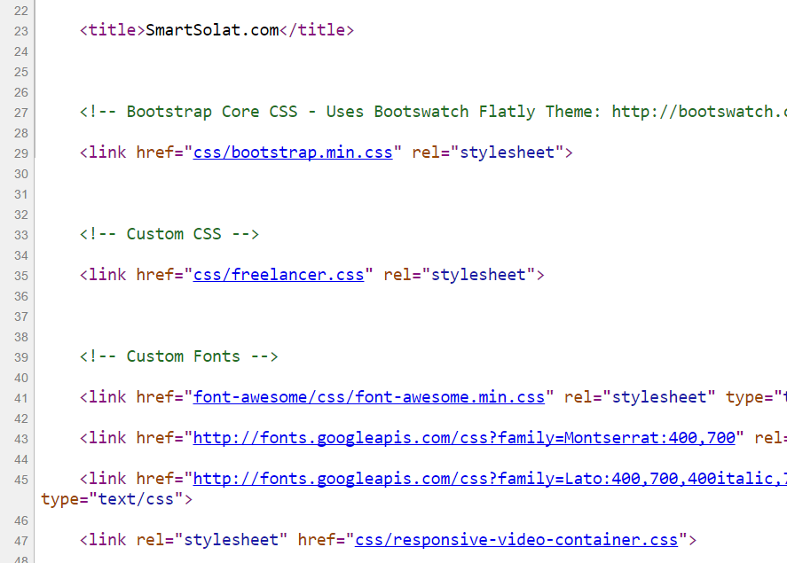
Bootstrap -setting
Copy the CSS script to the project folder.
> OR we can use CDN server

Slide 30
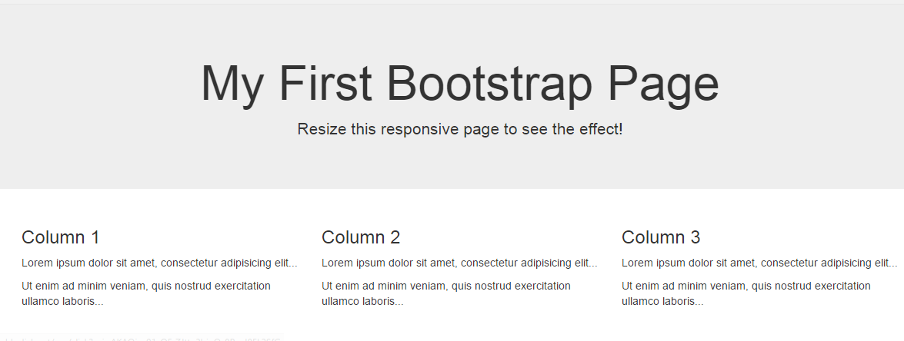
Basic bootstrap layout
Try it here http://www.w3schools.com/bootstrap/tryit.asp?filename=trybs_default&stacked=h

Slide 31
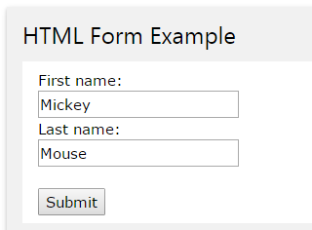
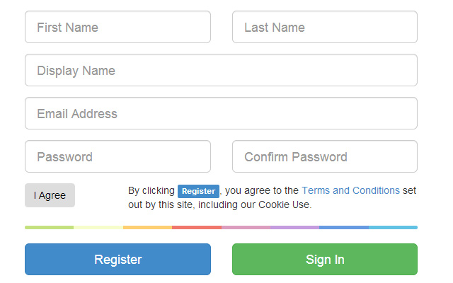
BOOTSTRAP FORM

Slide 32
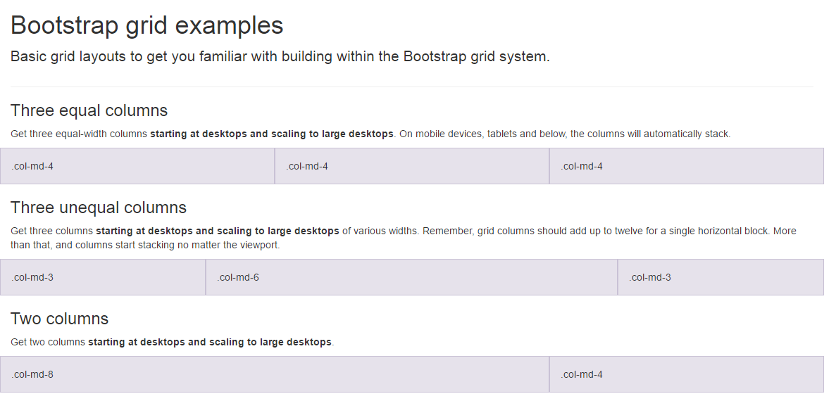
BootSTRAP GRID SYSTEM

Slide 33
BootSTRAP GRID SYSTEM DESKTOP
Banner
Main Content
Sidebar
Footer

Slide 34
BootSTRAP GRID SYSTEM MOBILE
Banner
Main Content
Sidebar
Footer

Slide 35
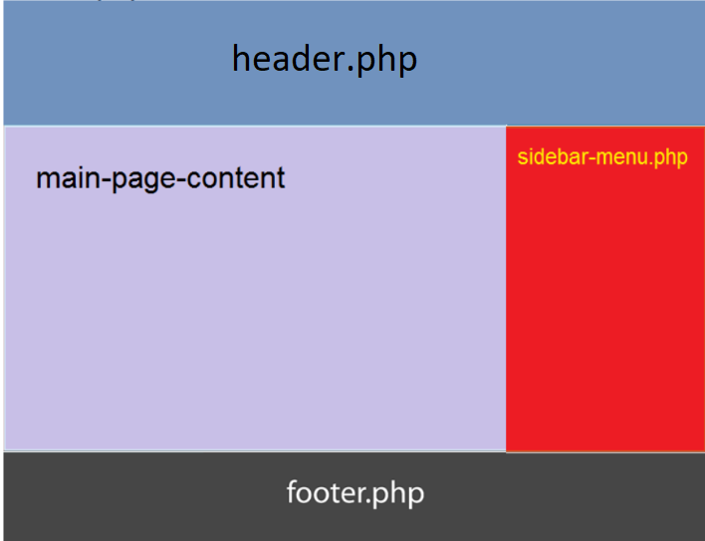
Include php
include (“header.php”);
<our content>
include (“footer.php”);

Slide 36

FREE STARTbootstrap.com
Example https://startbootstrap.com/

Slide 37
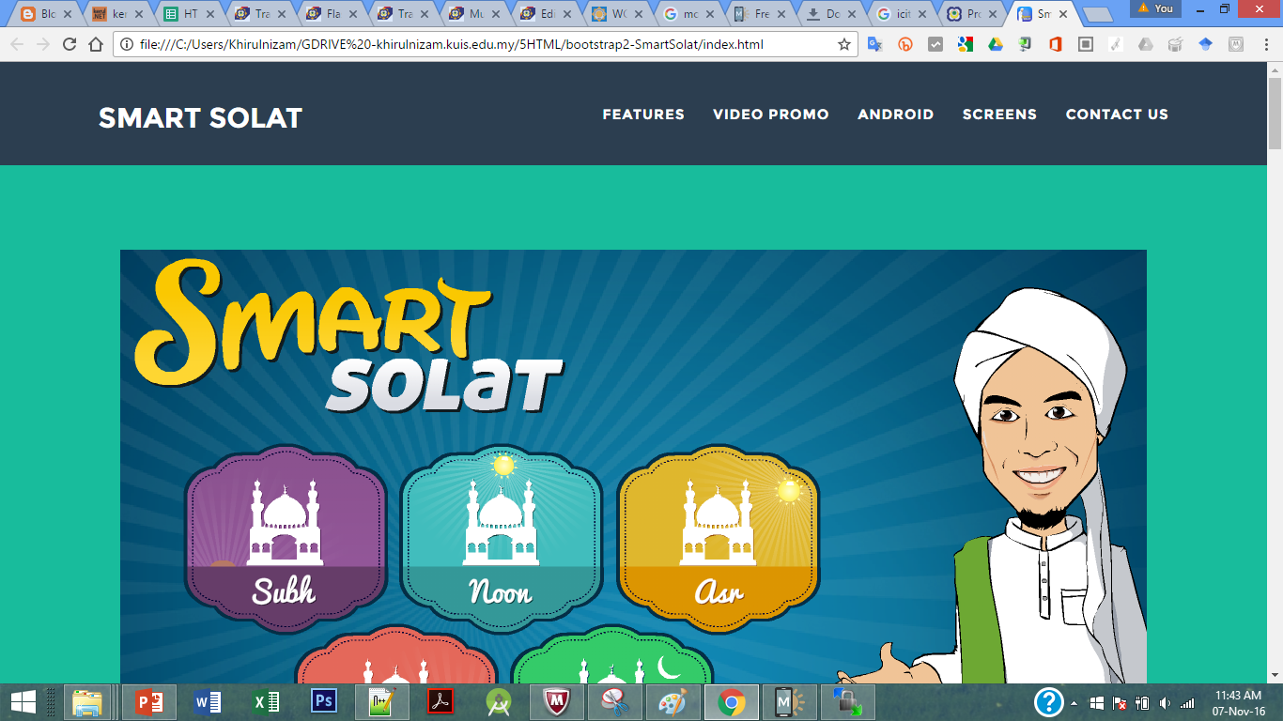
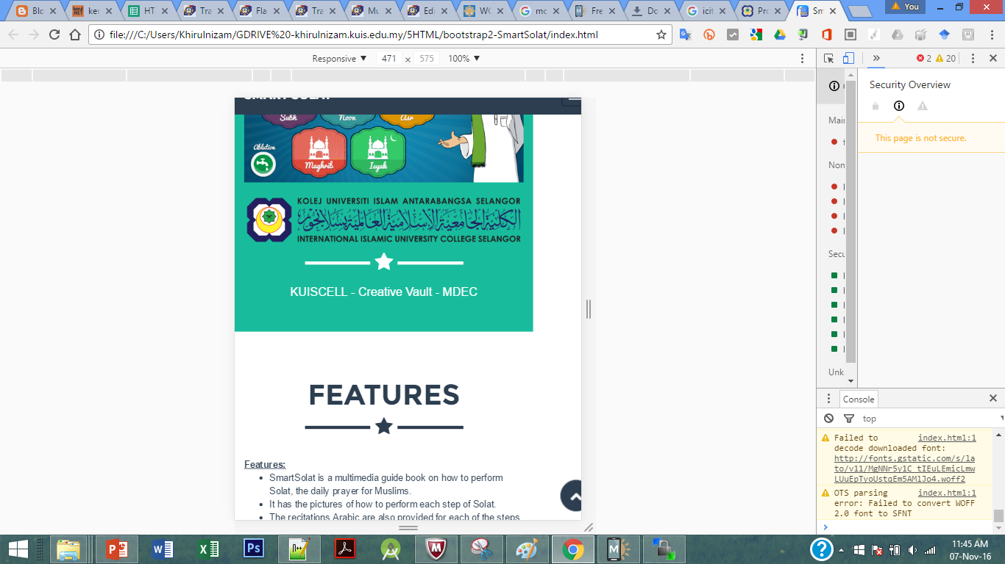
Sample2 - smartsolat

Slide 38
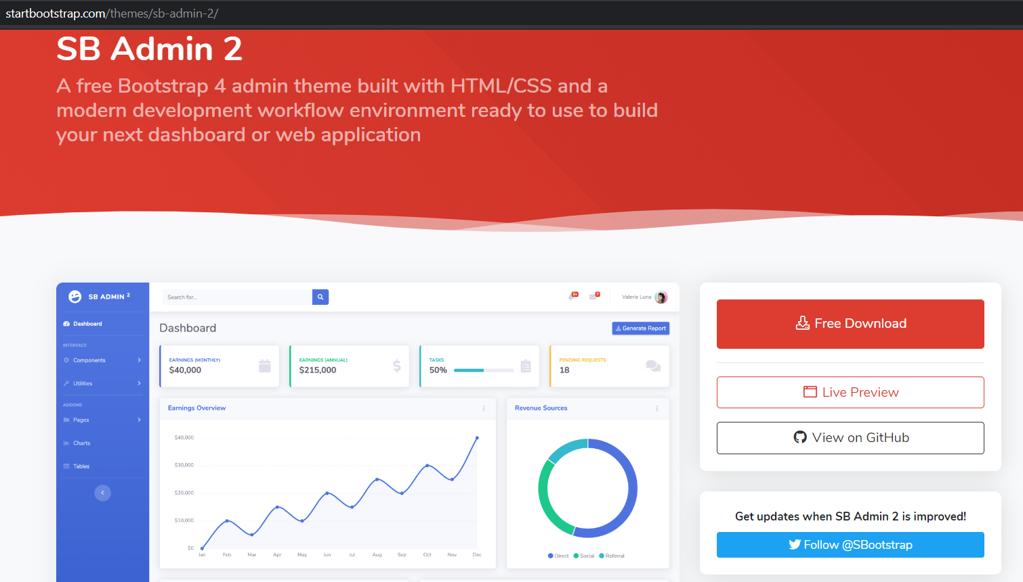
startbootstrap.com/themes/sb-admin-2/

Slide 39
T02.1 HTML + Bootstrap Form (Tutorial Bahasa Melayu)
bit.ly/fstmtubephp

Slide 40
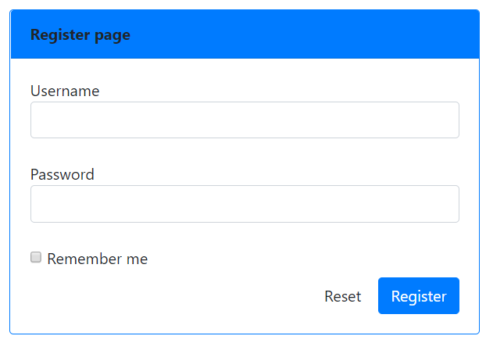
OUTPUT PREVIEW

Slide 41


CONNECT TO MYSQL DATABASE
mysqli
E-book PHP&Mysqli get it from
khirulnizam@gmail.com or
http://fb.com/khirulnizam or
Instagram @kerul_net
Video tutorial will cover mysqli

Slide 42
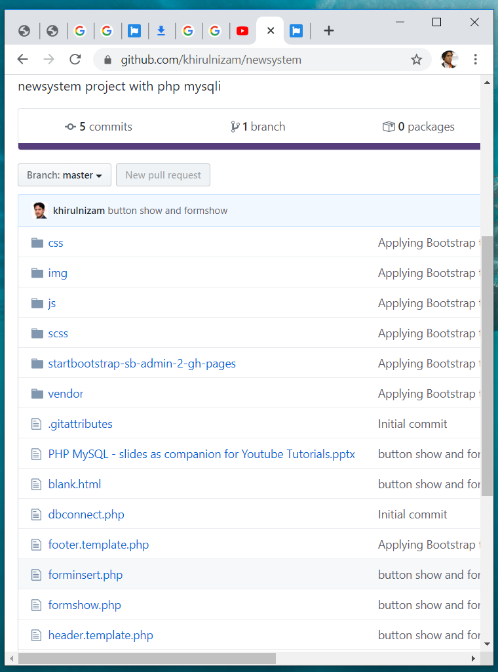

Code & Slides github.com/khirulnizam/ newsystem

Slide 43
BOOTSTRAP FORM

Slide 44
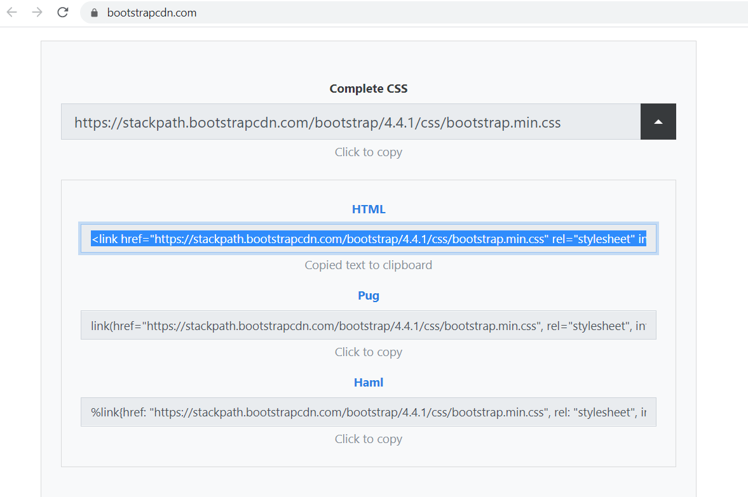
BootstrapCDN.com

Slide 45
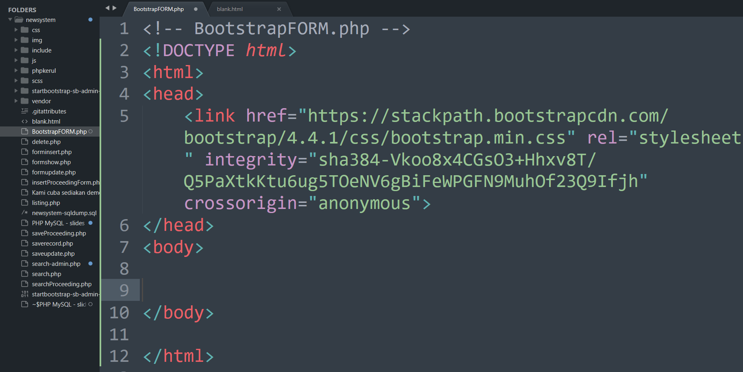

Slide 46
BootSTRAP GRID SYSTEM

Slide 47
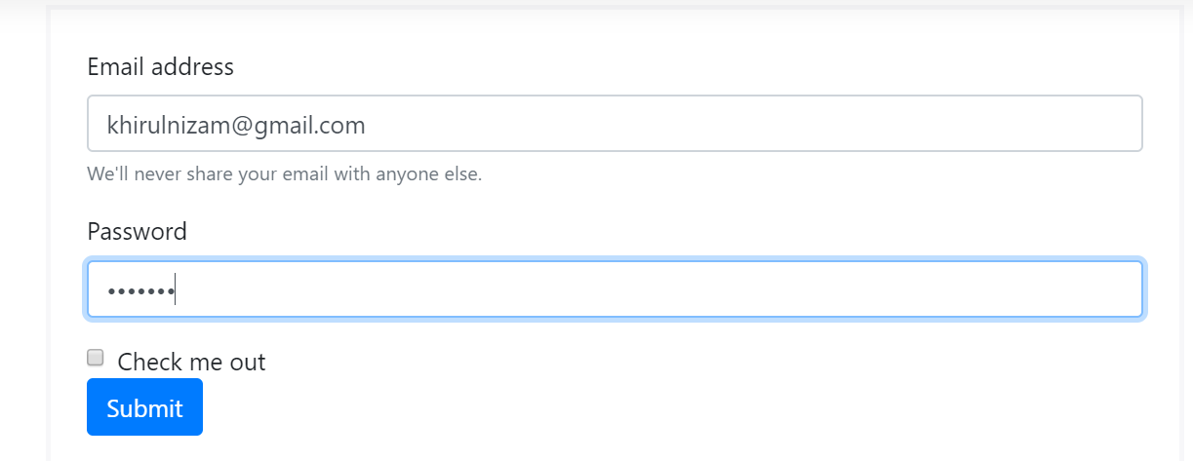
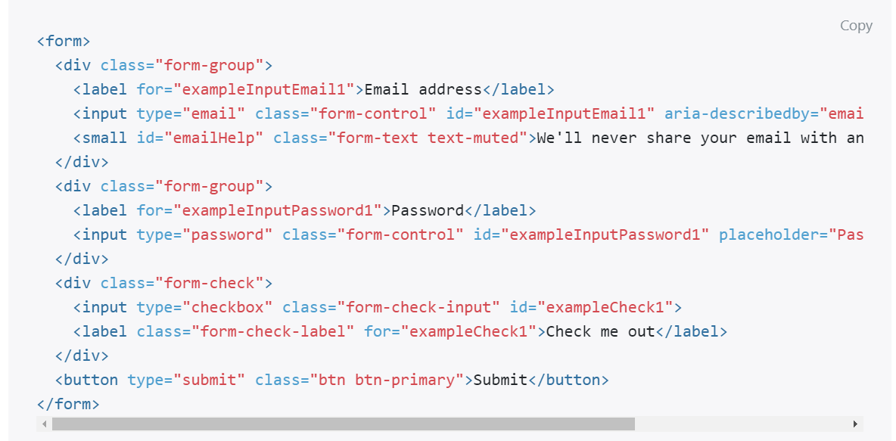
Email & PASSWORD

Slide 48
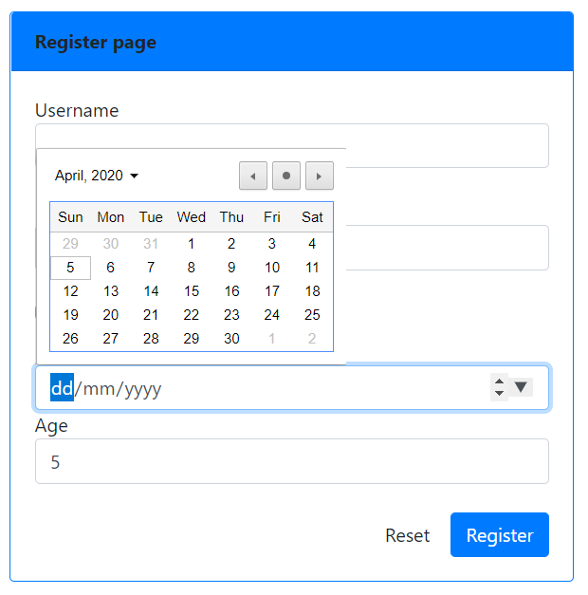
Date & NUMBER
<div >
Date of birth
<input type="date" name="dob" class="form-control">
Age
<input type="number" name="age" class="form-control">
</div>

Slide 49
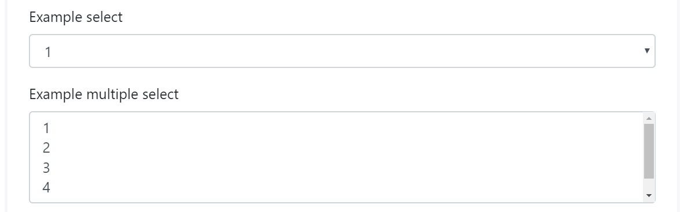
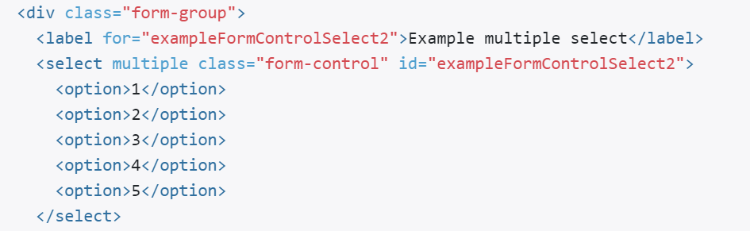
SELECT (DROP-DOWN)

Slide 50
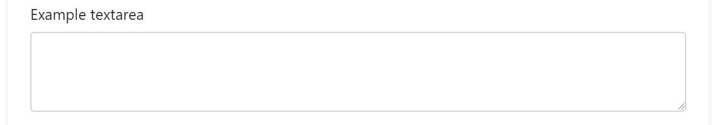
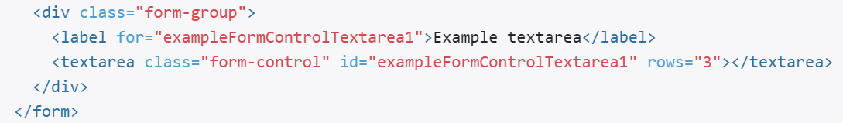
TEXTAREA

Slide 51
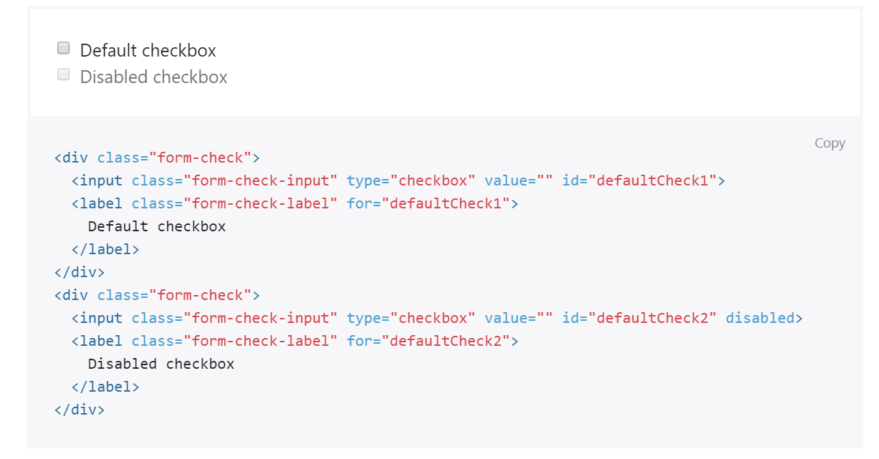
CHECKBOX

Slide 52
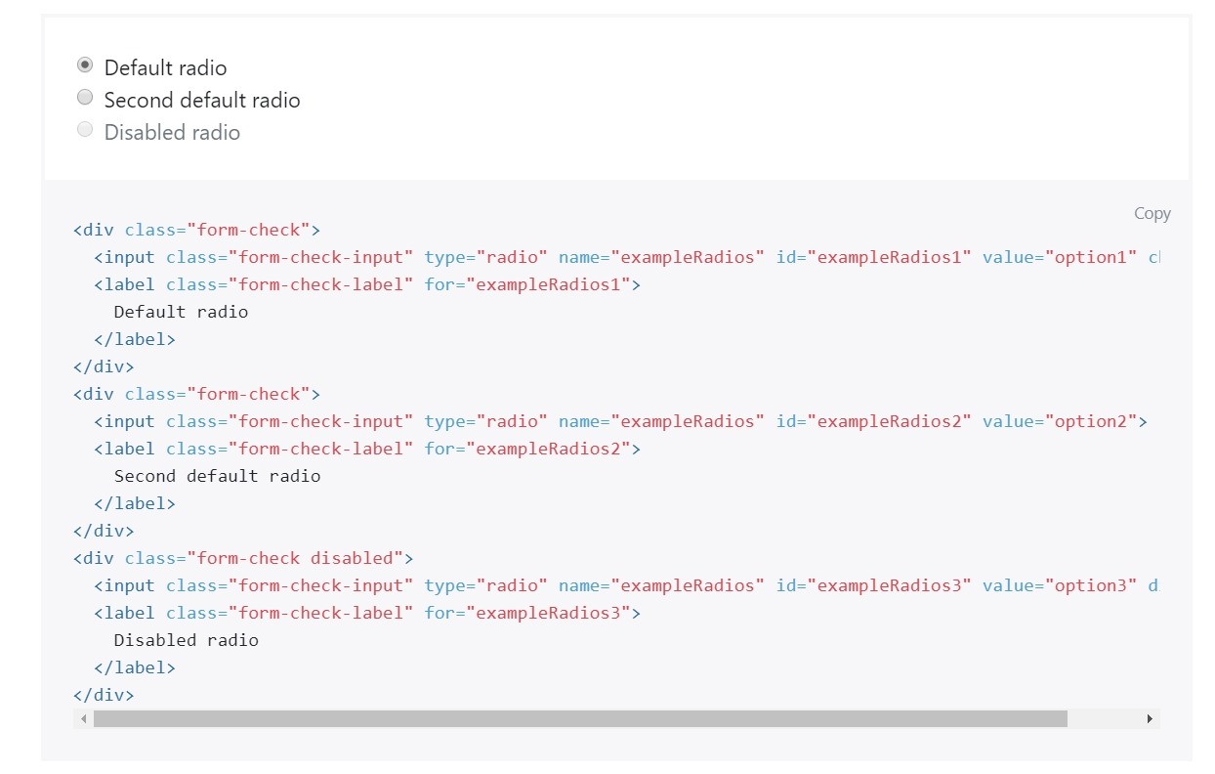
RADIO

Slide 53
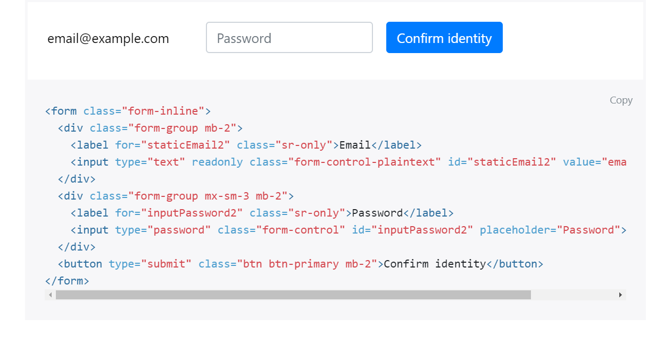
FORM-INLINE

Slide 54
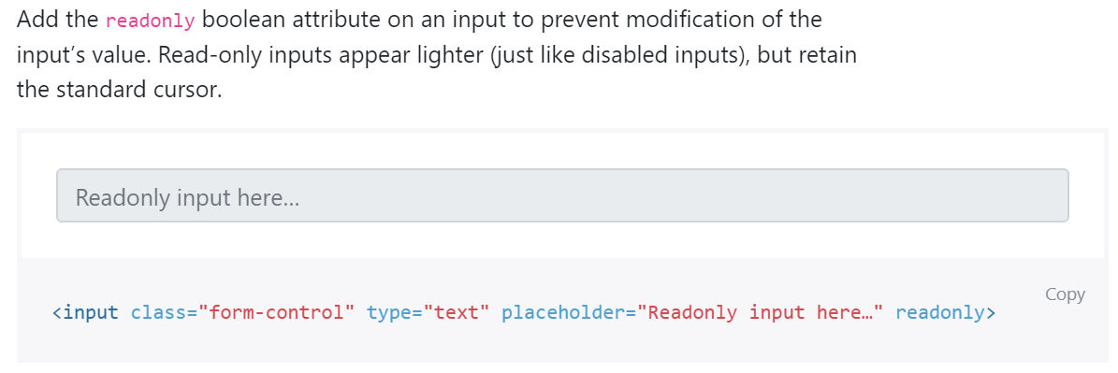
READONLY

Slide 55
DISABLED

Slide 56
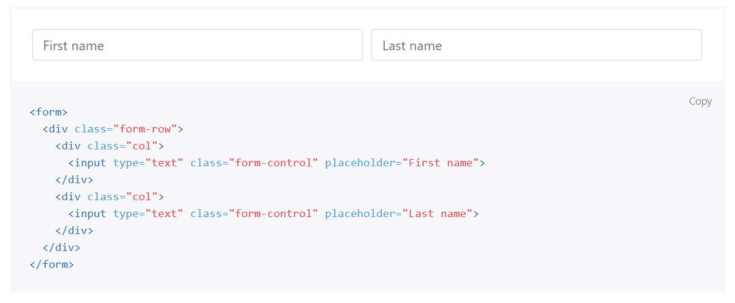
FROM GRID

Slide 57
OUTPUT PREVIEW

Slide 58
T03: PHP sintaks & echo Pembangunan System Web (Tutorial Bahasa Melayu)
bit.ly/fstmtubephp

Slide 59
T03: PHP SYNTAX & ECHO
w
bit.ly/fstmtube

Slide 60
Introduction
What is Web programming:
Combination of server-side and client-side to develop a dynamic website.
The application is deployed in the Web environment and can be access by multiple concurrent users.

Slide 61
Introduction to PHP
PHP= PHP: Hypertext Preprocessor:
Is a server-side scripting language.
PHP scripts are executed on the server, and the output from the process is inserted to the Web page as a part of the content before transmitted to the browser.
The script will not be sent to the browser which request the Web page, so the script is not visible to the users.

Slide 62
Introduction to PHP
Server-side Scripting | Client-side scripting
The script embedded inside the HTML page, interpreted and executed inside the server (the web server) and the result/output of the execution is sent to the browser. The script interpreted and executed inside the server. E.g.: PHP, ASP. | The script embedded inside the HTML page, downloaded with the HTML page and executed on the client (browser). E.g.: JavaScript.

Slide 63
Introduction to PHP
Why PHP?
Runs on different platforms (Windows, Linux, Unix, etc.).
Is compatible with almost all servers used today (Apache, IIS, etc.).
Is free to download.
Is easier to learn and runs efficiently on the server side.

Slide 64
PHP Script Tag
A PHP scripting block always starts with <?php and ends with ?>
A PHP scripting block can be placed anywhere in the document.
On servers with shorthand support enabled ( enable in php.ini) may start a scripting block with <? and end with ?>

Slide 65
PHP Script Tag
A PHP file normally contains HTML tags, just like an HTML file, and some PHP scripting code.
Next, we have an example of a simple PHP script which sends the text “Assalamualaikum" to the browser:

Slide 66
PHP Script Tag
<html>
<head>
<title> Web Programming </title>
</head>
<body>
<?php
echo "Assalamualaikum";
?>
</body>
</html>

Slide 67
PHP Script TAG
Each code line in PHP must end with a semicolon ( ; ).
The semicolon is a separator and is used to distinguish one set of instructions from another.

Slide 68
PHP Script Tag
There are two basic statements to output text with PHP: echo and print.
In the example before, we have used the echo statement to output the text "Assalamualaikum".

Slide 69
PHP ECHO
<?php
$txt="Assalamualaikum!";
$x=23;
echo "Assalamualaikum!";
echo $x;
?>

Slide 71
T04 SYNTAX PHP COMMENTS & VARIABLE
w
bit.ly/fstmtube

Slide 72
Comments in PHP
Comment is remark inside code that will not be compiled (ignored when the program is compiled).
It will not effect the code.
It is a good practice to write the comment.
Comment is useful the tell others what is the program is doing.
Helps programmer to memorize what is he doing.

Slide 73
Comments in PHP
In PHP, we use:
// to make a single-line comment or
/* … */ to make a large comment block.

Slide 74
Comments in PHP
<html>
<head>
<title> Web Programming </title>
</head>
<body>
<?php //This is a comment /* This is a comment block */ ?>
</body>
</html>

Slide 75
T05 SYNTAX PHP VARIABLES & CONCAT
w
bit.ly/fstmtube

Slide 76
PHP Variables
Variables are used for storing values, like text strings, numbers or arrays.
When a variable is declared, it can be used over and over again in your script.
All variables in PHP start with a $ sign symbol.
The correct way of declaring a variable in PHP:
Eg: $var_name = "Kerul";

Slide 77
PHP Variables (cont)
New PHP programmers often forget the
$
sign at the beginning of the variable.
In that case it will not work.
Let's try creating a variable containing a string and a variable containing a number:

Slide 78
PHP Variables (cont)
<?php
$txt="Assalamualaikum!";
$x=23;
echo $txt;
?>

Slide 79
EXAMPLE ON VARIABLE
Write the echo( )statement to display the following message:
Assalamualaikum!23

Slide 80
Naming Rules for Variables
A variable name must start with a $
A variable name can only contain alpha-numeric characters and underscores (a-z, A-Z, 0-9, and _ ).
A variable name should contain no space.
If a variable name is more than one word, it should be separated with an underscore ($my_string), or with capitalization ($myString).

Slide 81
EXAMPLE
Decide whether the following variables are valid or invalid. Give your reason.
$apa 11) $my_books
$123lekuk 12) $_myFamily
$what-is-the-number 13) $my address
$_uji1 14) $my2numbers
$my name
$For
IF
$float
$variable_to_hold_names_or_matrix_for_students
$hasil*nombor

Slide 82
Lateral Values
Lateral is the exact/actual value.
The value could be number (integer or real), character, string, or Boolean.

Slide 83
Lateral Values (cont)
Integer:
Integer is round number.
For example, 10 is an integer.
E.g.:
$num = 10;
$num = -10;
Use negative sign for negative numbers.

Slide 84
Lateral Values (cont)
Float:
E.g.:
$temp = 21.1225;
$product = 0.0;

Slide 85
Lateral Values (cont)
Characters:
To assign a character value into a char variable, the value must be put inside a open and close single or double quote.
E.g.:
$nama = 'Encik';
$name = "Kerul";

Slide 86
Lateral Values (cont)
Boolean:
There are only two values for Boolean variable: true and false.
E.g.:
$eatalready = true;
$isInteger = false;

Slide 87
Lateral Values (cont)
String:
A group of characters.
Marked with single or double quote.
E.g.:
$stmt = "How are you";

Slide 88
Concatenation Operator
There is only one string operator in PHP.
The concatenation operator ( . ) is used to put two string values together.
To concatenate two string variables together, use the concatenation operator:

Slide 89
Concatenation (cont)
<?php $txt1="Assalamualaikum!"; $txt2="Have a nice day!";
echo $txt1 . " " . $txt2; ?>

Slide 90
Concatenation (cont)
The simpler way in doing concatenation:
<?php $txt1="Assalamualaikum!"; $txt2="Have a nice day!";
echo "$txt1 $txt2"; ?>

Slide 91
Concatenation (cont)
Or, if you want to print the output in a separate line:
<?php $txt1="Assalamualaikum!"; $txt2="Have a nice day!";
echo "$txt1 <br> $txt2"; ?>

Slide 92
Concatenation (cont)
Array:
<?php $num[0]=3;
echo "Number ".$num[0];
echo "Number $num[0] ";//not possible
?>

Slide 93

T05+1 INPUT PROCESS OUTPUT
bit.ly/fstmtube

Slide 94
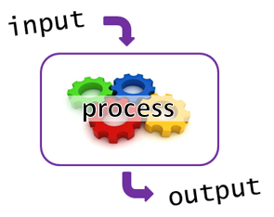
I-P-O
Input data
Process the data by converting into information
Output – convey the information as something meaningful

Slide 95
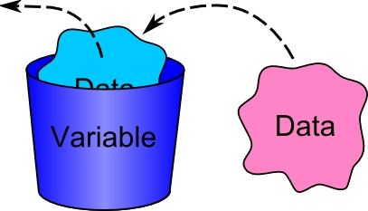
PHP Variables
Variables are used for storing values, like text strings, numbers or arrays.
All variables in PHP start with a $ sign symbol.
The correct way of declaring a variable in PHP:
Eg: $num1= 3; $num2=5;

Slide 96
Naming Rules for Variables
A variable name must start with a $
A variable name can only contain alpha-numeric characters and underscores (a-z, A-Z, 0-9, and _ ).
A variable name should contain no space.
If a variable name is more than one word, it should be separated with an underscore ($my_string), or with capitalization ($myString).

Slide 97
Arithmetic Operations
Operator | Operation | Example
 |  | Mathematical expression | PHP expression
+ | Addition | num1 + 3 | $total=$n1 + $n2;
- | Subtraction | pi - y | $q=$pi - $y;
* | Multiplication | width x height | $area=$width * $height;
/ | Division | a/b | $div=$a/$b;
% | Modulus | num modulo 2 | $even=$nom%3;

Slide 98
PROCESS: ADD 2 NUMBERS
Input process output
$num2 3
$num1 5
$total 8

Slide 99
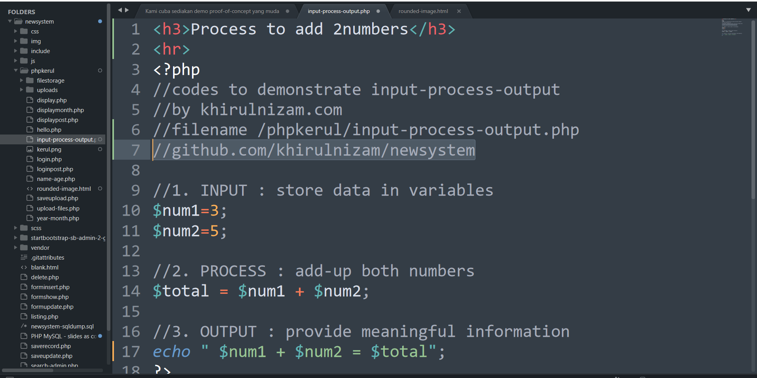
github.com/khirulnizam/newsystem

Slide 100
T06 FORM INPUT
w
bit.ly/fstmtube

Slide 101
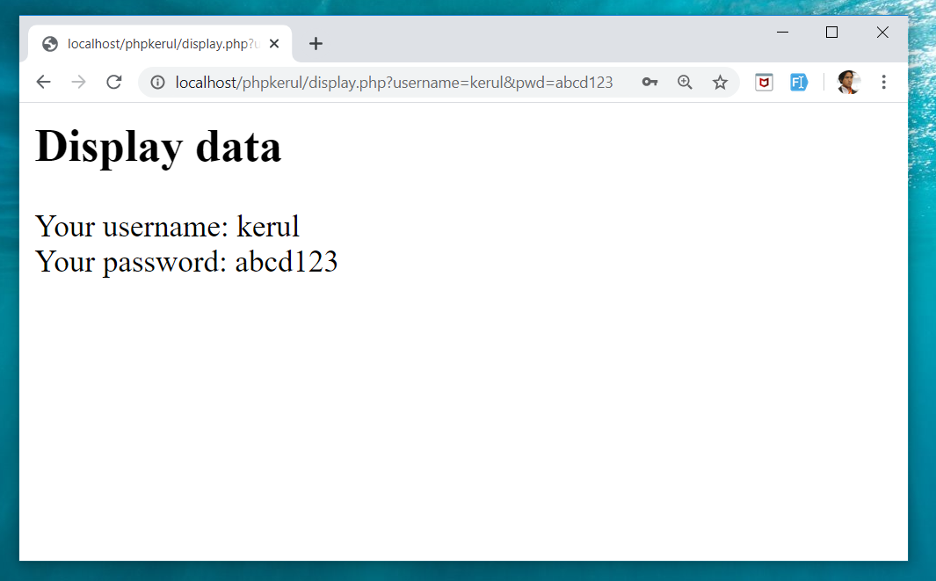
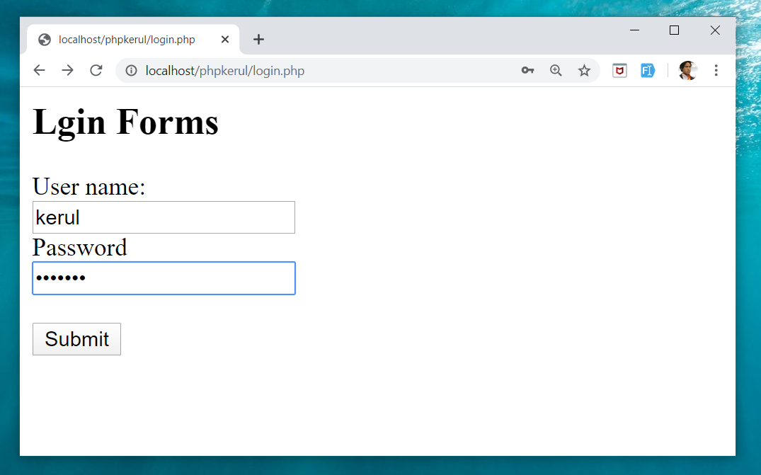
Example (cont)

Slide 102
Input Through HTML
<form name=“aform” method=“GET” action=“save.php”>
input…
</form>
This is the typical structure of form:
name: is the name of the form.
method: how the data is transferred (POST or GET).
action: is the target file resides in the Web server that receive the data from the form.
input: are the input elements (text field, checkbox, radio button, etc.).

Slide 103
GET vs. POST
GET | POST
Is basically for just getting (retrieving) data. The variable name and the value appear and visible in the URL. Form data is to be encoded (by a browser) into at the end of the URL of the target file. | Form data is embedded within a message body. POST may involve anything, like storing files to the server, updating data, ordering a product, or sending an e-mail. The variable name and the value do not appear in the URL.

Slide 104
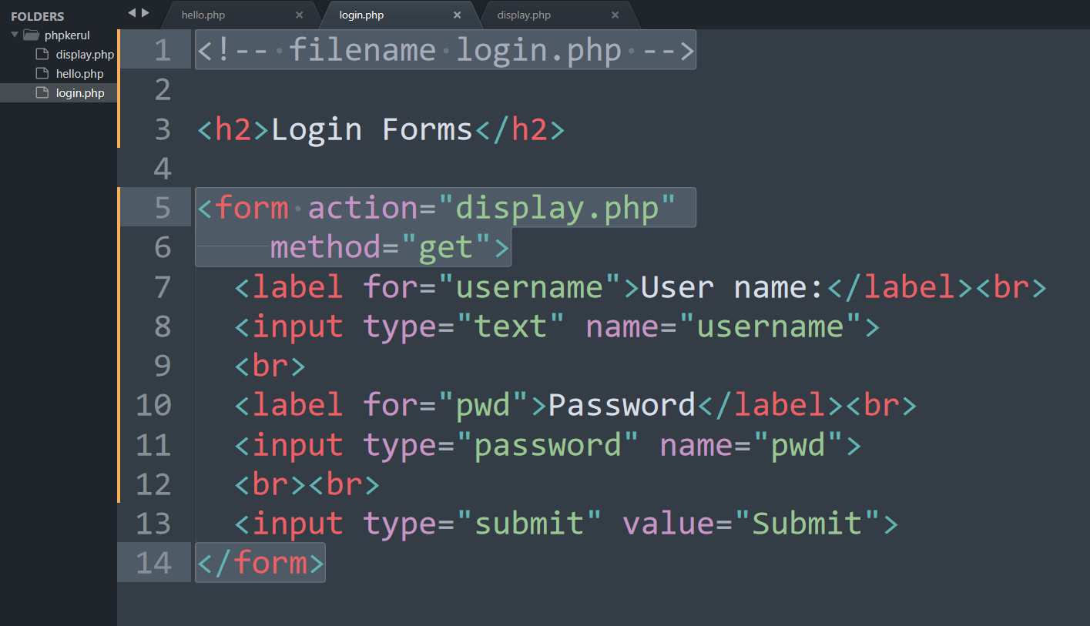
Example (Using GET Method)

Slide 105
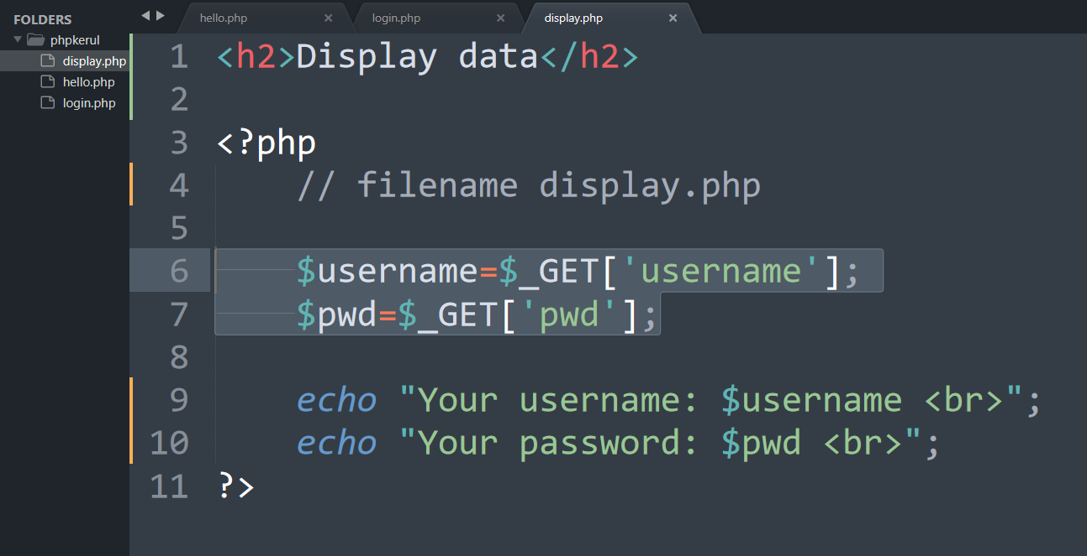
Display.php

Slide 106
Example (cont)

Slide 107
Example (Using POST Method)

Slide 108
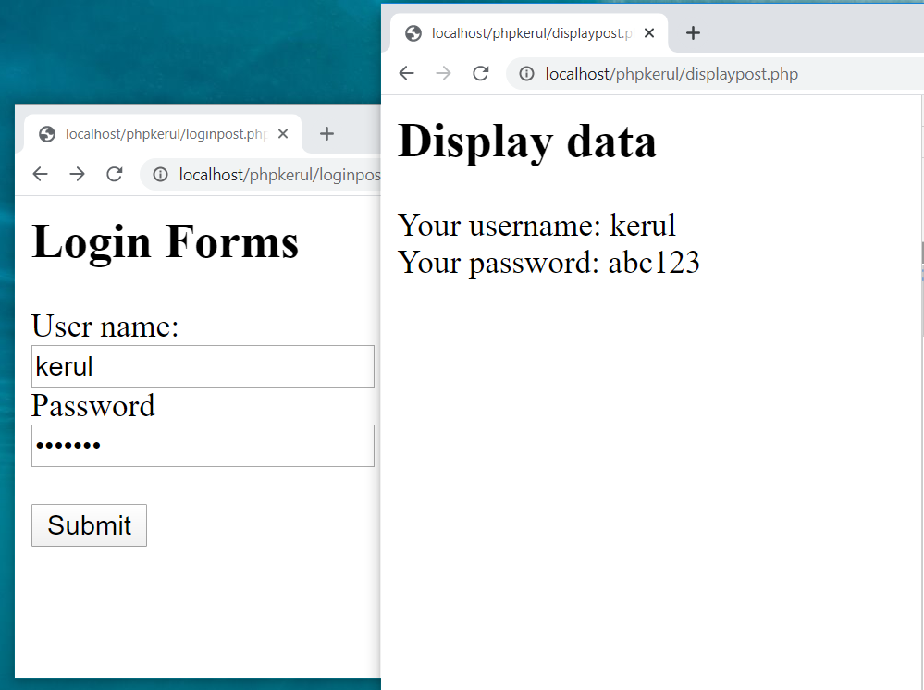

Slide 109
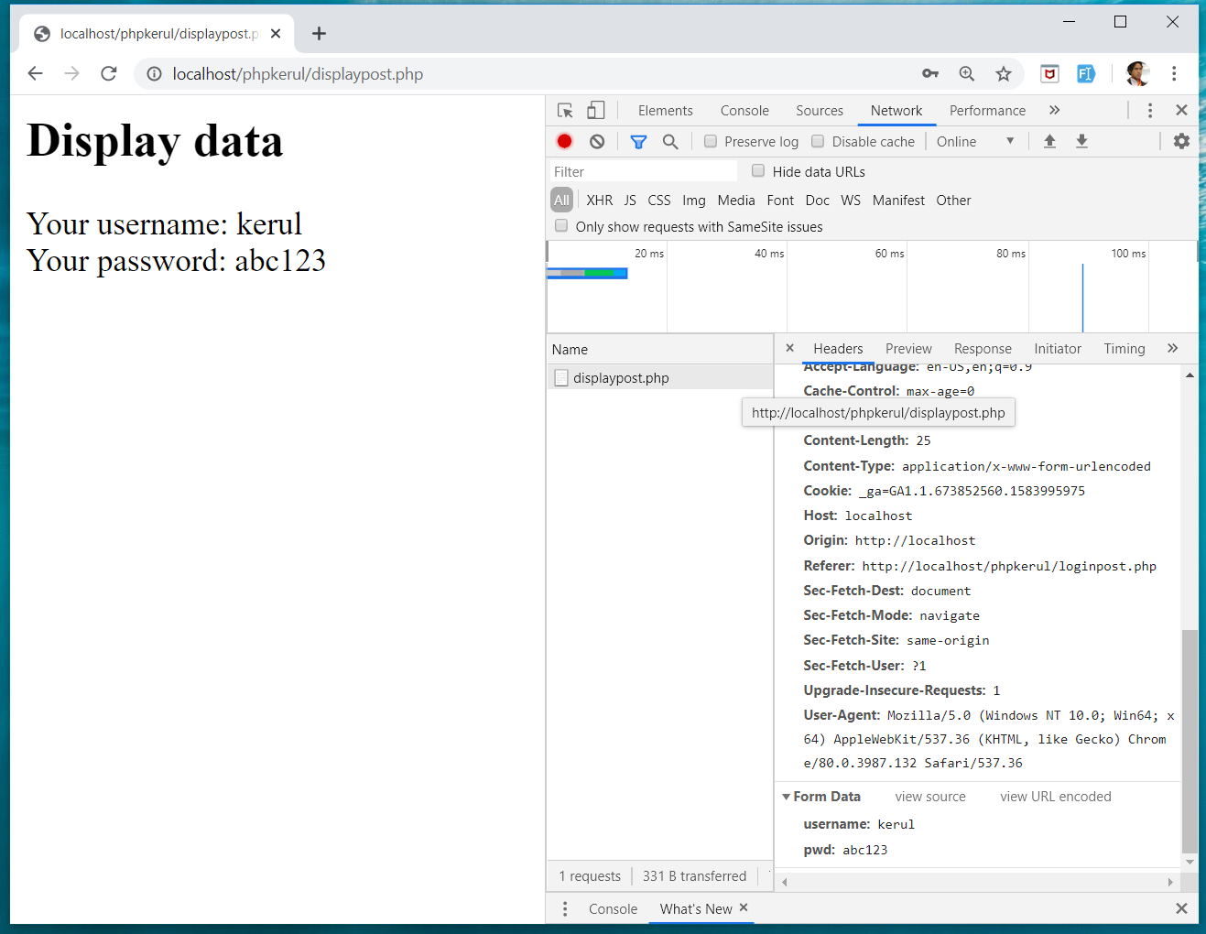
INSPECT TOOLS
F12

Slide 110
T07 SELECTION (PILIHAN) IF…Else
w
bit.ly/fstmtube

Slide 111
Comparison Operators
Operator | Meaning | Example
== | Equal to | ($num == 100)
!= | Not equal to | ($letter != ‘Z’)
< | Less than | ($num1 < $num2)
> | Greater than | ($mark > 80)
<= | Less than or equal to | ($sum <= 10)
>= | Greater than or equal to | ($sum >= $input)

Slide 112
Selection in PHP
if is a PHP reserved words to perform selection:
Simple if: for one choice selection
if…else: for two choices selection

Slide 113
Simple if
E.g.:
if ($grade == 'A')
echo 'Excellent';
else if ($grade == 'F')
echo 'Try again’;
else

Slide 114
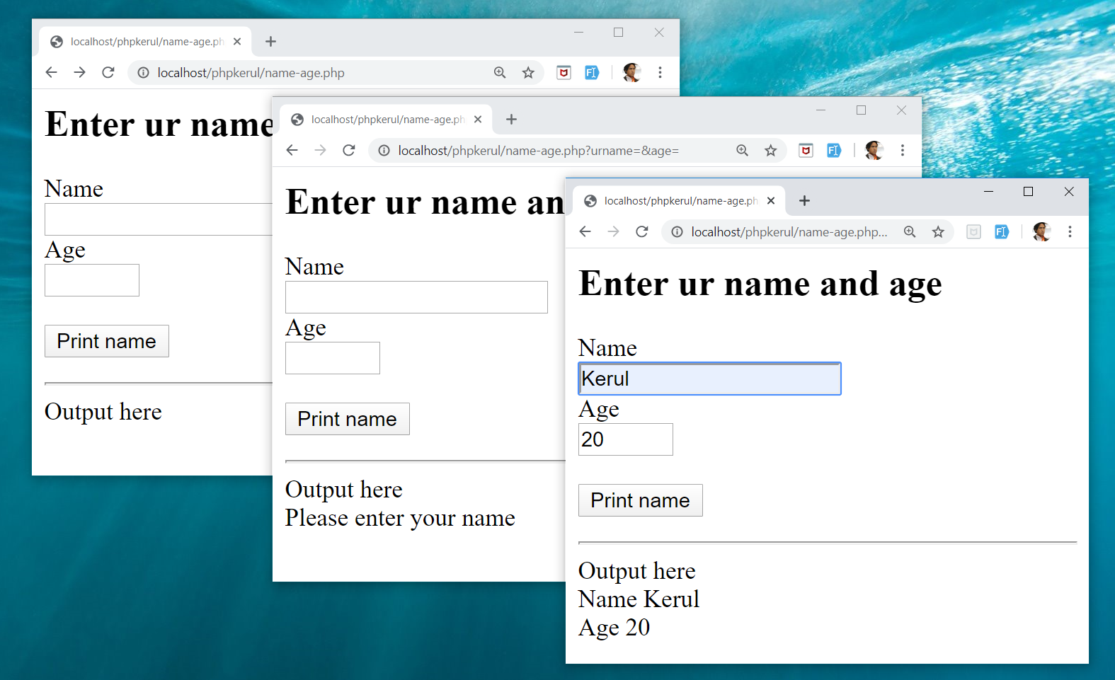
Example

Slide 115
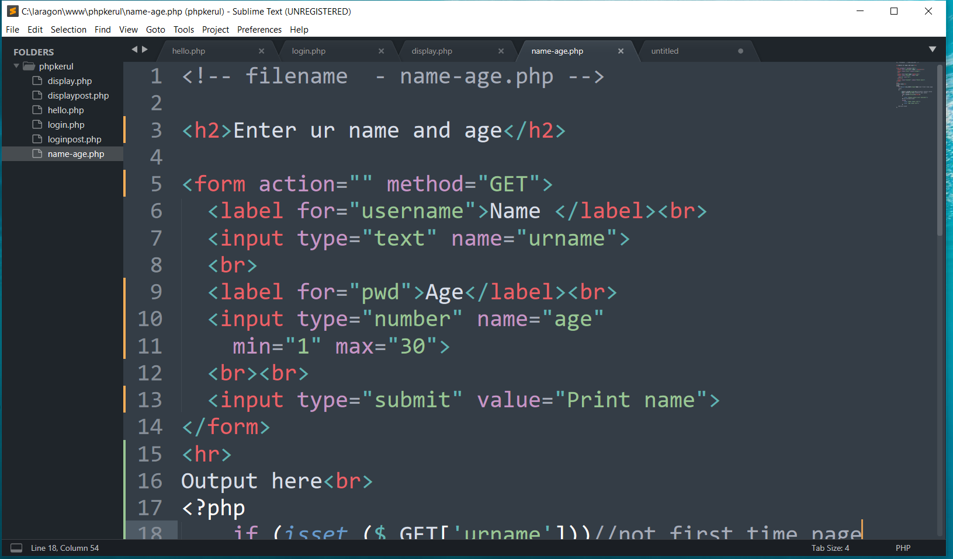
FORM (name-age.php )

Slide 116
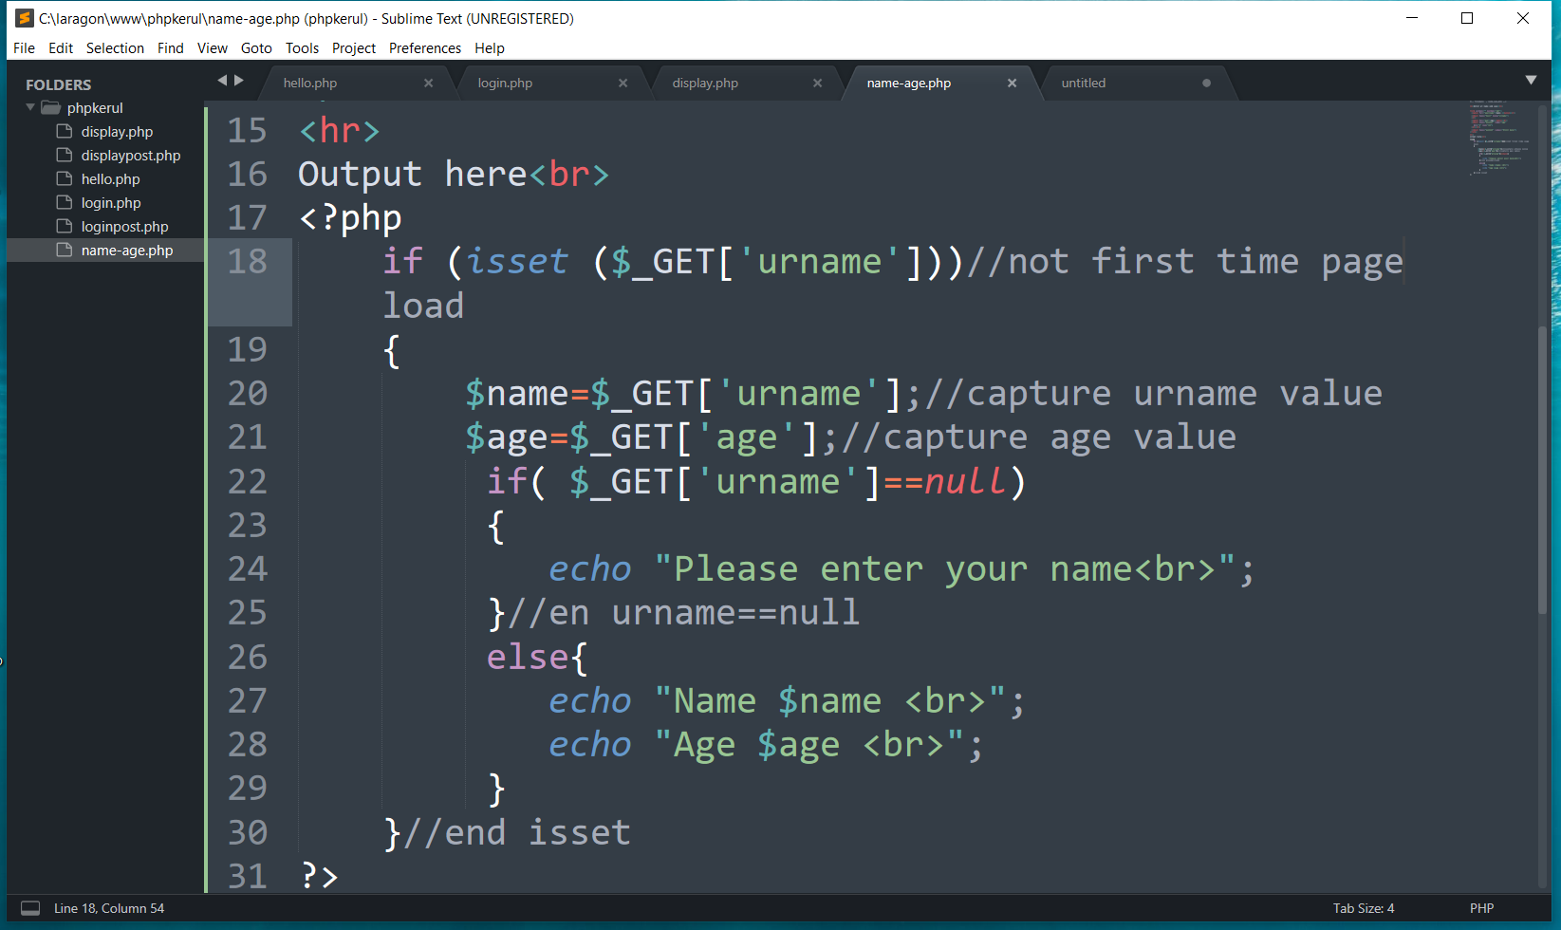
THE PHP IF…ELSE

Slide 117
T08 ITERATION (ULANGAN) FOR LOOp
w
bit.ly/fstmtube

Slide 118
Repetition in PHP
There are many ways of doing repetition. Three of them:
for
while and do…while
foreach

Slide 119
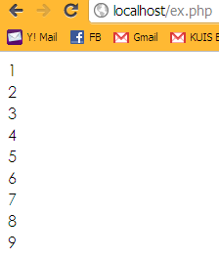
for structure
E.g.:
<?php
for ($i=1; $i<=9;$i++){
echo "$i<br>";
}
?>

Slide 120
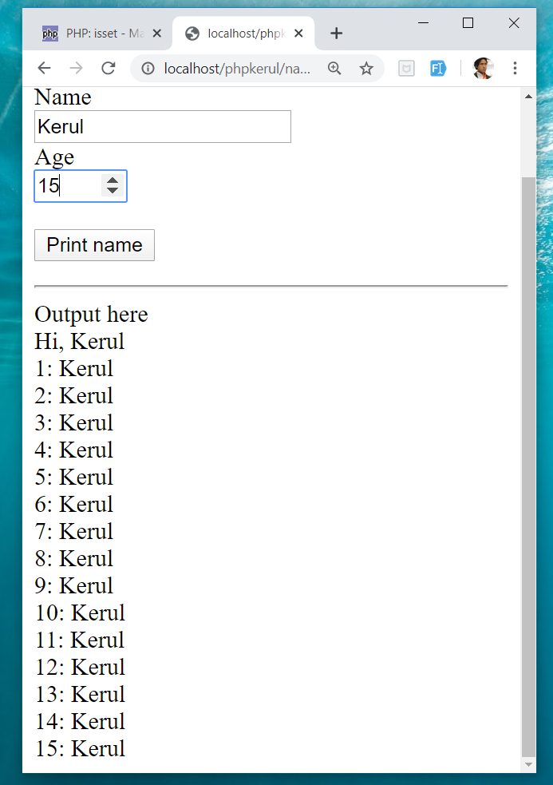
OUTPUT SAMPLE

Slide 121
T09 ARRAY (TATASUSUNAN) FOREACH
w
bit.ly/fstmtube

Slide 122
Introduction of Array
A variable is a storage area holding a number or text. The problem is a variable hold only one value.
An array is a special variable, which can store multiple values in one single variable.

Slide 123
Introduction of Array (cont)
If you have a list of items (a list of student names, for e.g.), storing the student names in single variables could look like this:
$std1="Anas"; $std2="Hajar"; $std3="Shah";

Slide 124
Introduction of Array
In PHP, there are 3 kind of arrays:
Numeric array - An array with a numeric index.
Assign using AUTOMATIC method.
Assign using MANUAL method.
Associative array - An array where each ID key is associated with a value.
Multidimensional array - An array containing one or more arrays.

Slide 125
Numeric Array
Assign using AUTOMATIC method (the index starts at 0).
$std = array("Anas", "Hajar", "Shah", "Nurul");
Assign using MANUAL method.
$std[0]="Anas"; $std[1]="Hajar"; $std[2]="Shah"; $std[3]="Nurul";

Slide 126
Example
<?php
$std[0]="Anas";
$std[1]="Hajar";
$std[2]="Shah";
$std[3]="Nurul";
echo $std[0] . " and " . $std[1] . " are students of FSTM.";
?>

Slide 127
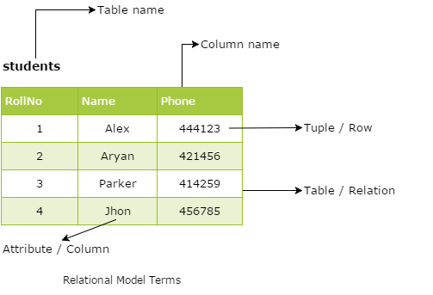
Associative Array
$record['rollno' ]=5;
$record['name']="Kerul";
$record['phone’]=90346;

Slide 128


DISPLAY YEARS in DROPDOWN

Slide 129

SELECT
OPTION

Slide 130

FOREACH

Slide 131
T10 FILE UPLOAD (MUAT-NAIK FAIL)
w
bit.ly/fstmtube

Slide 132
DISCLAIMER
Codes are for demo purposes. Example showed here are only to validate the proof of concepts. Security aspect the demonstrated examples are beyond the coverage of these tutorials. You are advised to explore / sought after advanced topics of PHP web programming as the issues are covered in the advanced level.

Slide 133
move_uploaded_file function
The move_uploaded_file() function moves an uploaded file to a new location.
This function returns TRUE on success, or FALSE on failure.
Syntax:
move_uploaded_file(file,newloc)
file: Specifies the file name.
newloc: Specifies the new location (destination) for the file.

Slide 134
PHP.ini
In php settings ( locate file php.ini from Laragon), turn-on the file upload
file_uploads = On

Slide 135
UPLOAD FORM (ONLY FOR IMAGE)
<!DOCTYPE html> <html> <body> <form action= "saveupload.php" method="post" enctype="multipart/form-data"> Select image to upload: <input type="file" name="fileToUpload" <input type="submit" value="Upload Image" name="submit"> </form> </body> </html>

Slide 136

enctype
enctype="multipart/form-data" - POST request with file-upload, have to encode the data that forms the body of the request.
<input name="fileToUpload" type="file" > - the form control to choose a file and upload to server.

Slide 137

OUTPUT

Slide 138

PHP to store image in server
Source: www.w3schools.com/php/php_file_upload.asp

Slide 139

PHP to store image in server
Source: www.w3schools.com/php/php_file_upload.asp

Slide 140

PHP to store image in server
Source: www.w3schools.com/php/php_file_upload.asp

Slide 141
OUTPUT

Slide 142

T11 php OOP (PENGATURCARAAN BERASASKAN OBJEK)
bit.ly/fstmtube

Slide 143





OOP
Object Oriented Programming - We can imagine our surroundings are full of objects cars, trees, houses, etc. Same way there is object oriented programming concepts which assume everything as an object and implement a software/system parts using different objects.
w3schools

Slide 144



FUNCTION IN PHP
A function is a block of statements that can be used repeatedly in a program.
Without arguments.
With arguments.

Slide 145
MODULAR PHP FUNCTION
Tokenization
Post Tagging
Vocab
Outside Vocab
Annotati
Output generation
Input file

Slide 146
Class
PHP OOP
Methods
Properties
Classes and objects are the two main aspects of object-oriented programming.
Class
Method/function
Object call
Constructor
Static method/property
Inheritance

Slide 147

PHP Class

Slide 148

CLASS Method

Slide 149


PHP Class with Constructor

Slide 150
PHP Object Call

Slide 151


STATIC METHOD/PROPERTIES
w3schools

Slide 152

INHERITANCE
Inheritance in OOP = When a class derives from another class.
The child class will inherit all the public and protected properties and methods from the parent class. In addition, it can have its own properties and methods.
An inherited class is defined by using the extends keyword.
Parent /
Superclass
Child/Subclass

Slide 153

EXAMPLE ON INHERITANCE

Slide 154

INHERITANCE: PHP FRAMEWORK
bit.ly/fstmtubelaravel

Slide 155

T12 PREPARING MYSQL DATABASE SERVER (PANGKALAN DATA)
bit.ly/fstmtubephpmysql

Slide 156

T12 PREPARING MYSQL DATABASE SERVER (PANGKALAN DATA)
bit.ly/fstmtubephpmysql

Slide 157
DISCLAIMER
Codes are for demo purposes. Example showed here are only to validate the proof of concepts. Security aspect the demonstrated examples are beyond the coverage of these tutorials. You are advised to explore / sought after advanced/security topics of PHP web programming as these tutorials only for beginner level.

Slide 158
CONNECT TO MYSQL DATABASE
mysqli/PDO
E-book PHP&Mysqli get it from
khirulnizam@gmail.com or
http://fb.com/khirulnizam or
Instagram @kerul_net
These vids tutorial will cover mysqli/PDO

Slide 159

CHANGE DBSERVER ROOT PASSWORD

Slide 160

ENTER PASSWORD

Slide 161


START ALL

Slide 162


CREATE NEW DB

Slide 163

HEIDI SQL (MYSQL CILENT)

Slide 164

CREATE NEW TABLE
Right-click on dbname

Slide 165

TABLE STRUCTURE : STUDENTS
Table name: students
set auto_increment for field id

Slide 166

POPULATE DUMMY DATA
Right-click to insert new row

Slide 167
T13 DBCONNECT PDO (PANGKALAN DATA PDO)
bit.ly/fstmtubephpmysql

Slide 168
T13 DBCONNECT PDO (PANGKALAN DATA PDO)
bit.ly/fstmtubephpmysql

Slide 169
DISCLAIMER
Codes are for demo purposes. Example showed here are only to validate the proof of concepts. Security aspect the demonstrated examples are beyond the coverage of these tutorials. You are advised to explore / sought after advanced/security topics of PHP web programming as these tutorials only for beginner level.

Slide 170
CONNECT TO MYSQL DATABASE
mysqli/PDO
E-book PHP&Mysqli get it from
khirulnizam@gmail.com or
http://fb.com/khirulnizam or
Instagram @kerul_net
These vids tutorial will cover mysqli/PDO

Slide 171

WHY PDO ?
PDO – PHP Data Object
Support different database
mysqli – only for MySQL
database connection
https://www.php.net/manual/en/book.pdo.php

Slide 172

TEST DBCONNECT TO DATABASE

Slide 173

HOW TO DISPLAY ALL RECORDS

Slide 174

EMBED SQL STATEMENT

Slide 175

SUBSCRIBE FSTM KUIS CHANNEL

Slide 176
T14 DBCONNECT using mysqli (Pangkalan Data mysqli)
bit.ly/fstmtubephpmysql

Slide 177
STAY HOME5, SAVE MALAYSIA! t14: mysqli
bit.ly/fstmphpmysqli

Slide 178
DISCLAIMER
Codes are for demo purposes. Example showed here are only to validate the proof of concepts. Security aspect the demonstrated examples are beyond the coverage of these tutorials. You are advised to explore / sought after advanced/security topics of PHP web programming as these tutorials only for beginner level.
Suitable to view in DESKTOP

Slide 179
CONNECT TO MYSQL DATABASE
mysqli
E-book PHP&Mysqli get it from
khirulnizam@gmail.com or
http://fb.com/khirulnizam or
Instagram @kerul_net
These vids tutorial will cover mysqli

Slide 180
3-tier – DATABASE CONNECTION
Tier3 : Database
Tier1 : Client/browser
Tier2 : Middleware (Webserver + PHP)

Slide 181

CREATE NEW DB

Slide 182

PREPARE DATABASE NAME & TABLE

Slide 183
mysqli_connect ( )
<?php
$servername = "localhost";//server location / IP number
$username = "root";//db admin username
$password = "abcd1234";//password for db admin username
$dbname = "newsystem";//database name
// Create connection
$conn = mysqli_connect($servername, $username,
$password, $dbname);

Slide 184

mysqli_connect ( )

Slide 185

TEST SQL COMMANDS

Slide 186
MSQLI FUNCTIONS
$result = mysqli_query($conn, $sql)
PHP.net/mysqli_query : Performs an SQL query on the database
if (mysqli_num_rows($result) > 0)
PHP.net/mysqli_num_rows : Gets the number of rows in a result
while($row = mysqli_fetch_assoc($result)) {
PHP.net/mysqli_fetch_assoc : Fetch a result row as an associative array

Slide 187
Associative Array
$record['rollno']=5;
$record['name']="Kerul";
$record['phone’]=90346;

Slide 188

EMBED SQL IN PHP

Slide 189

DISPLAY RESULT SET

Slide 190
SUBSCRIBE FSTM KUIS CHANNEL

Slide 191
T15 SEARCH IN DB (Carian dalam DB)
bit.ly/fstmtubephpmysql

Slide 192
DISCLAIMER
Codes are for demo purposes. Example showed here are only to validate the proof of concepts. Security aspect the demonstrated examples are beyond the coverage of these video tutorials. You are advised to explore / sought after advanced/security topics of PHP web programming as these tutorials only for beginner level.
Suitable to view in DESKTOP

Slide 193
CONNECT TO MYSQL DATABASE
mysqli
E-book PHP&Mysqli get it from
khirulnizam@gmail.com or
http://fb.com/khirulnizam or
Instagram @kerul_net
Video tutorial will cover mysqli

Slide 194
Code & Slides github.com/khirulnizam/ newsystem

Slide 195

CODE: search.php

Slide 196

POPULATE DATA INSIDE TABLE

Slide 197
Next

Slide 198

T16 BOOTSTRAP TEMPLATE
bit.ly/fstmtphpmysqli

Slide 199
EXAMPLE OF IMPLEMENTATION

Slide 200
GITHUB
https://github.com/khirulnizam/newsystem

Slide 201
DISCLAIMER
Codes are for demo purposes. Example showed here are only to validate the proof of concepts. Security aspect the demonstrated examples are beyond the coverage of these video tutorials. You are advised to explore / sought after advanced/security topics of PHP web programming as these tutorials only for beginner level.
Suitable to view in DESKTOP

Slide 202
CONNECT TO MYSQL DATABASE
mysqli
E-book PHP&Mysqli get it from
khirulnizam@gmail.com or
http://fb.com/khirulnizam or
Instagram @kerul_net
Video tutorial will cover mysqli

Slide 203
Include php
include ("header.php");
<our content>
include ("footer.php");

Slide 204
startbootstrap.com/themes/sb-admin-2/

Slide 205
EXAMPLE OF IMPLEMENTATION

Slide 206

T17 INSERT RECORD (MASUKKAN REKOD BAHARU)
bit.ly/fstmtphpmysqli

Slide 207
EXAMPLE OF IMPLEMENTATION

Slide 208
GITHUB
https://github.com/khirulnizam/newsystem

Slide 209
DISCLAIMER
Codes are for demo purposes. Example showed here are only to validate the proof of concepts. Security aspect the demonstrated examples are beyond the coverage of these video tutorials. You are advised to explore / sought after advanced/security topics of PHP web programming as these tutorials only for beginner level.
Suitable to view in DESKTOP

Slide 210
CONNECT TO MYSQL DATABASE
mysqli
E-book PHP&Mysqli get it from
khirulnizam@gmail.com or
http://fb.com/khirulnizam or
Instagram @kerul_net
Video tutorial will cover mysqli

Slide 211
OVERVIEW

Slide 212

forminsert.php

Slide 213

forminsert.php

Slide 214

forminsert.php

Slide 215

INSERT INTO

Slide 216

T18 SHOW DETAILS (Paparan semua data rekod)
bit.ly/fstmphpbootstrap

Slide 217

OVERVIEW

Slide 218
DISCLAIMER
Codes are for demo purposes. Example showed here are only to validate the proof of concepts. Security aspect the demonstrated examples are beyond the coverage of these video tutorials. You are advised to explore / sought after advanced/security topics of PHP web programming as these tutorials only for beginner level.
Suitable to view in DESKTOP

Slide 219
CONNECT TO MYSQL DATABASE
mysqli
E-book PHP&Mysqli get it from
khirulnizam@gmail.com or
http://fb.com/khirulnizam or
Instagram @kerul_net
Video tutorial will cover mysqli

Slide 220
Code & Slides github.com/khirulnizam/ newsystem

Slide 221
OVERVIEW

Slide 222
search-admin.php

Slide 223


Slide 224
formshow.php

Slide 225


Slide 226


Slide 227


Slide 228
Code & Slides github.com/khirulnizam/ newsystem

Slide 229

T19 UPDATE RECORD (Kemaskini data rekod)
bit.ly/fstmphpbootstrap

Slide 230

UPDATE RECORD PROCESS
search-admin.php
id
id

Slide 231
OVERVIEW
Cancel
Save Record

Slide 232
DISCLAIMER
Codes are for demo purposes. Example showed here are only to validate the proof of concepts. Security aspect the demonstrated examples are beyond the coverage of these video tutorials. You are advised to explore / sought after advanced/security topics of PHP web programming as these tutorials only for beginner level.
Suitable to view in DESKTOP

Slide 233
CONNECT TO MYSQL DATABASE
mysqli
E-book PHP&Mysqli get it from
khirulnizam@gmail.com or
http://fb.com/khirulnizam or
Instagram @kerul_net
Video tutorial will cover mysqli

Slide 234
Code & Slides github.com/khirulnizam/ newsystem

Slide 235

UPDATE COMMAND SQL

Slide 236

T20 DELETE RECORD (Padam rekod)
bit.ly/fstmphpbootstrap

Slide 237

UPDATE RECORD PROCESS
search-admin.php
id
confirmdelete( )
id

Slide 238
OVERVIEW
Save Record

Slide 239
DISCLAIMER
Codes are for demo purposes. Example showed here are only to validate the proof of concepts. Security aspect the demonstrated examples are beyond the coverage of these video tutorials. You are advised to explore / sought after advanced/security topics of PHP web programming as these tutorials only for beginner level.
Suitable to view in DESKTOP

Slide 240
CONNECT TO MYSQL DATABASE
mysqli
E-book PHP&Mysqli get it from
khirulnizam@gmail.com or
http://fb.com/khirulnizam or
Instagram @kerul_net
Video tutorial will cover mysqli

Slide 241
Code & Slides github.com/khirulnizam/ newsystem

Slide 242

UPDATE COMMAND SQL

Slide 243
T21 INNER JOIN (Gabungan dua jadual)

Slide 244


1-Many relationship

Slide 245
DISCLAIMER
Codes are for demo purposes. Example showed here are only to validate the proof of concepts. Security aspect the demonstrated examples are beyond the coverage of these video tutorials. You are advised to explore / sought after advanced/security topics of PHP web programming as these tutorials only for beginner level.
Suitable to view in DESKTOP

Slide 246
CONNECT TO MYSQL DATABASE
mysqli
E-book PHP&Mysqli get it from
khirulnizam@gmail.com or
http://fb.com/khirulnizam or
Instagram @kerul_net
Video tutorial will cover mysqli

Slide 247
Code & Slides github.com/khirulnizam/ newsystem

Slide 248

DISPLAY OPTIONS FROM TABLE TO DROP-DOWN

Slide 249

OUTPUT

Slide 250
T22 INNER JOIN DISPLAY (Papar gabungan dua jadual)

Slide 252
1-Many relationship

Slide 253
DISCLAIMER
Codes are for demo purposes. Example showed here are only to validate the proof of concepts. Security aspect the demonstrated examples are beyond the coverage of these video tutorials. You are advised to explore / sought after advanced/security topics of PHP web programming as these tutorials only for beginner level.
Suitable to view in DESKTOP

Slide 254
CONNECT TO MYSQL DATABASE
mysqli
E-book PHP&Mysqli get it from
khirulnizam@gmail.com or
http://fb.com/khirulnizam or
Instagram @kerul_net
Video tutorial will cover mysqli

Slide 255
1-Many relationship

Slide 256

SQL: INNER JOIN

Slide 257

OUTPUT

Slide 258


MOBIRISE
Mobirise – a free web design studio that support HTML5 & Bootstrap’s famous ‘block’ design.

Slide 259

MOBIRISE
Done with the talking, lets walk the talk… ;)

Slide 260

Select theme

Slide 261

Start here

Slide 262

Select block

Slide 263


Slide 265

MOBIRES- CHANGING IMAGE

Slide 266

MOBIRES- TEXT EDITING

Slide 267


Slide 268


Slide 269

Thank you very much
Newton keep asking, Why apple FALL from tree?
Everybody asks silly questions before becoming a star…

